Slide 1
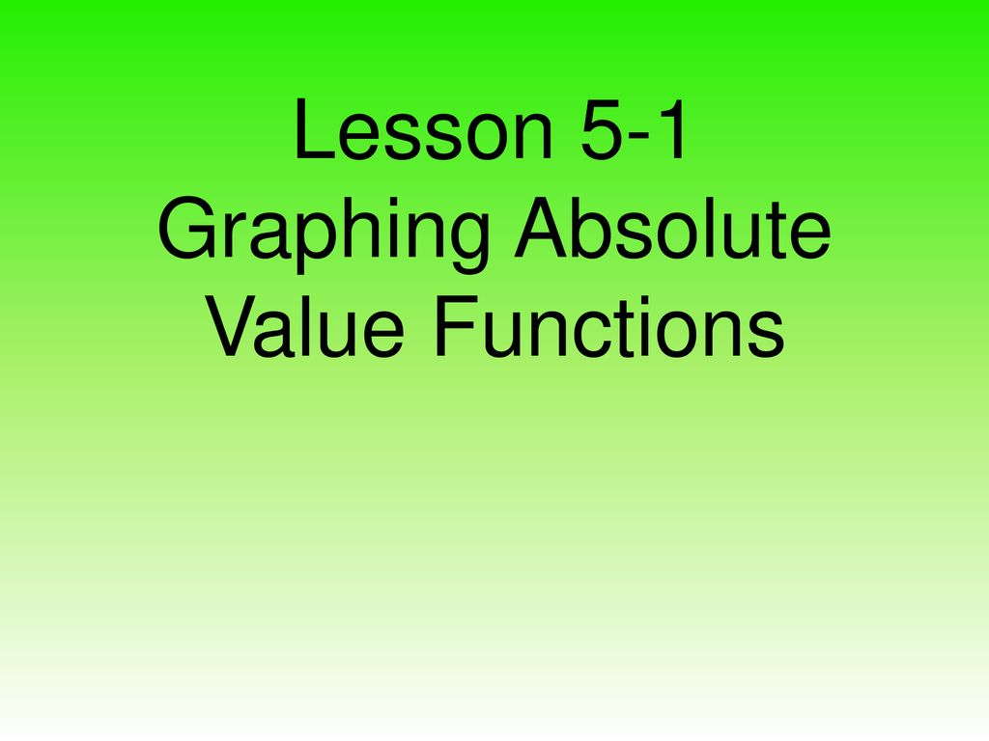

Slide 2
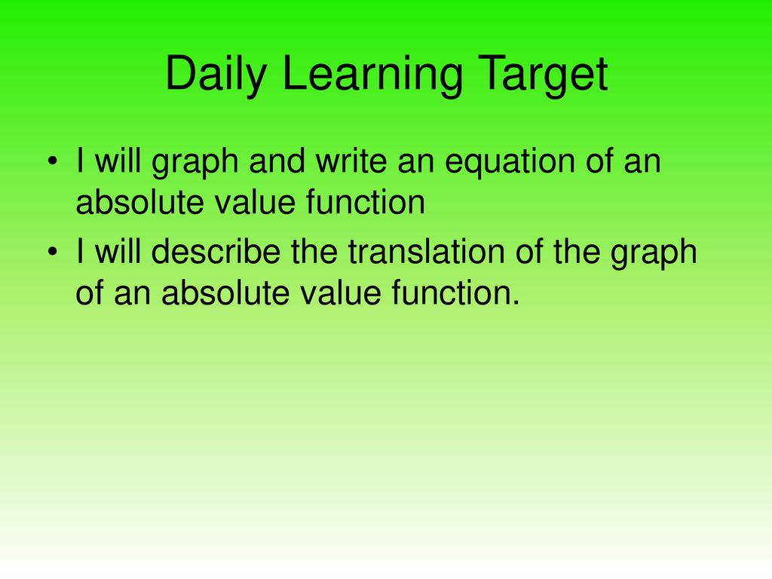
Graphing

Slide 3
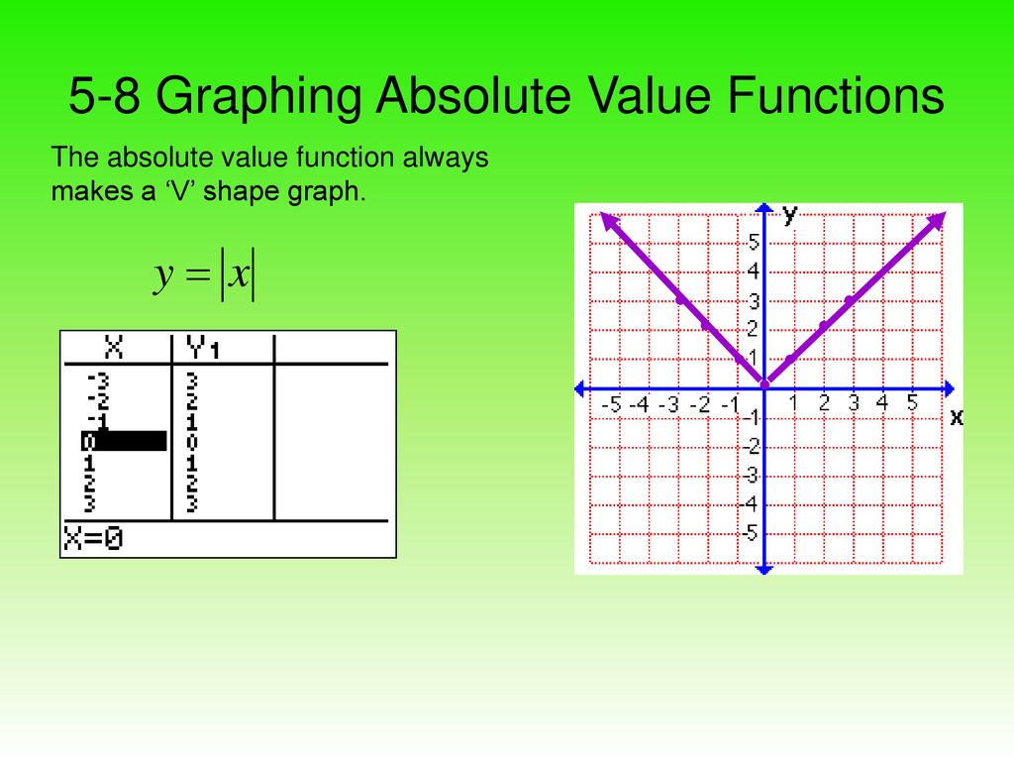

Slide 4
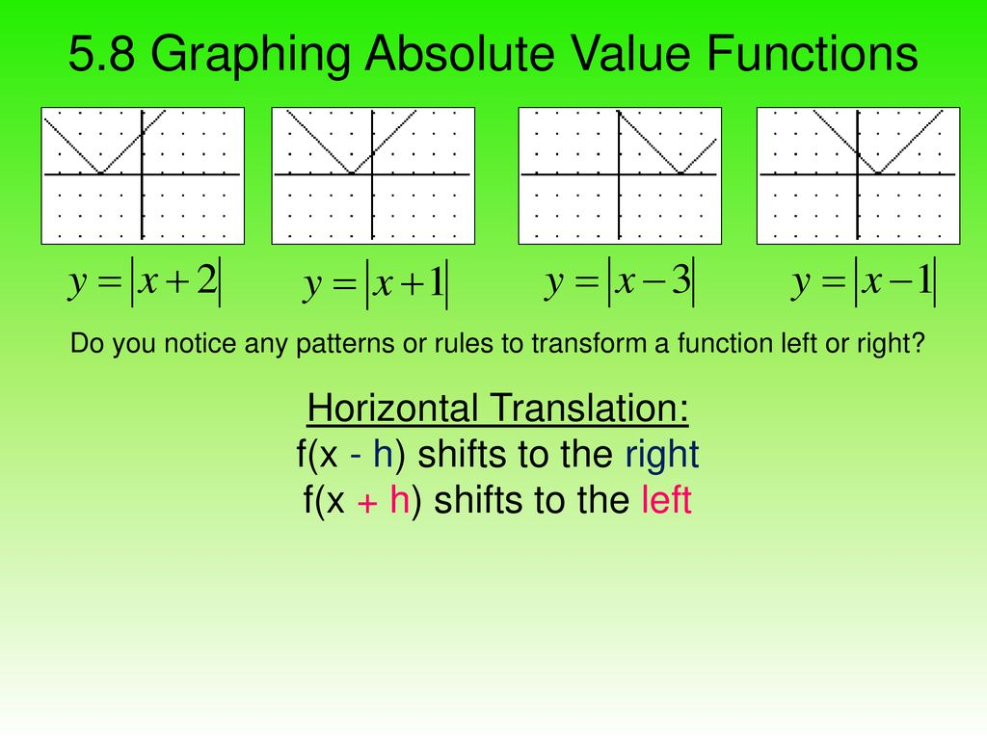

Slide 5
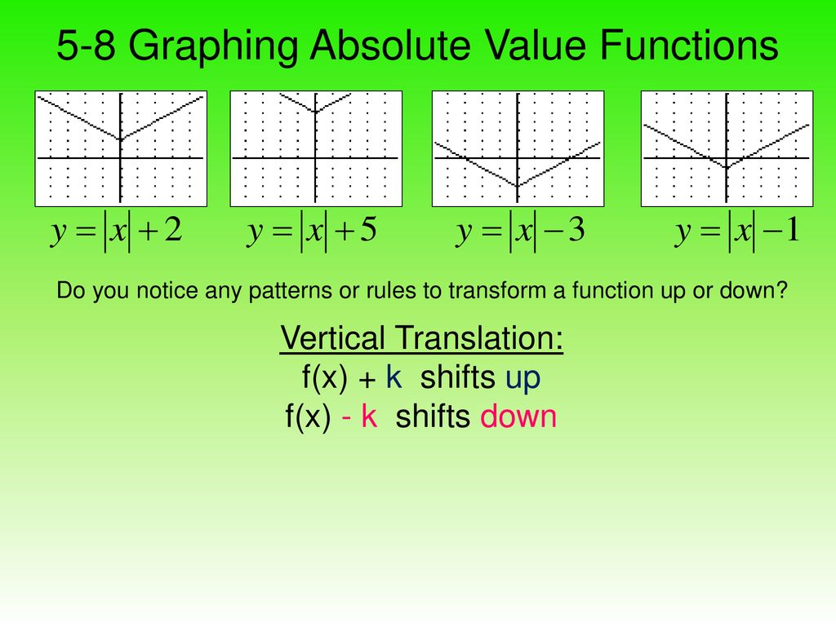
Vertical Translation

Slide 6
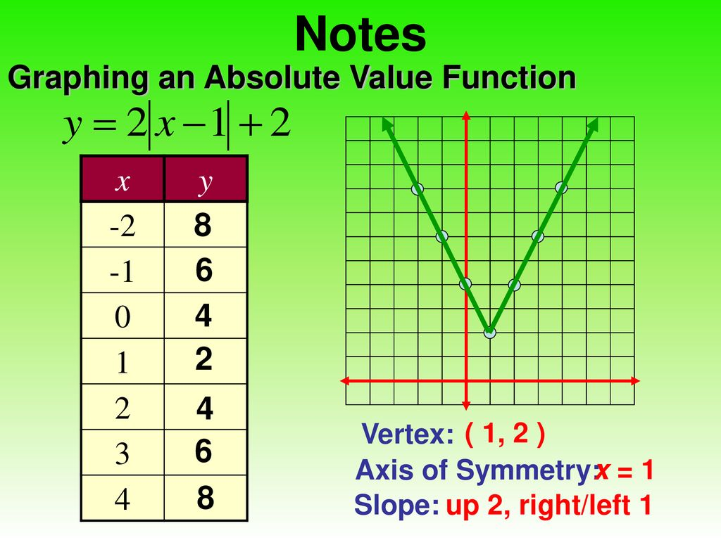

Slide 7
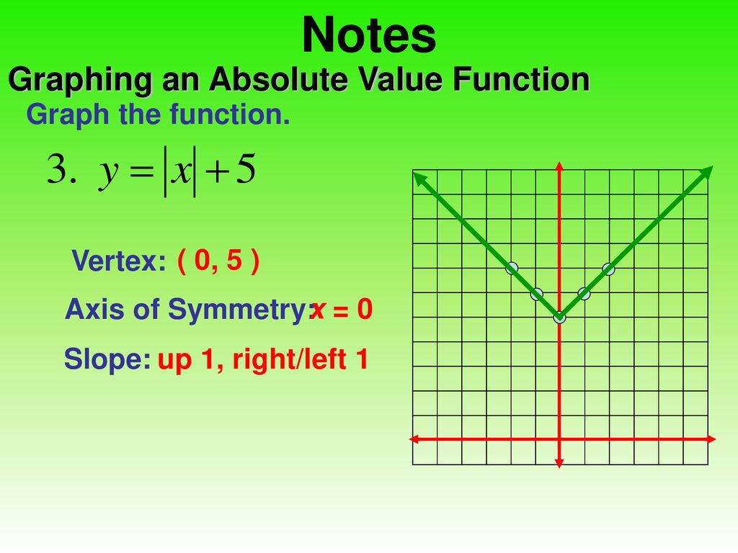

Slide 8
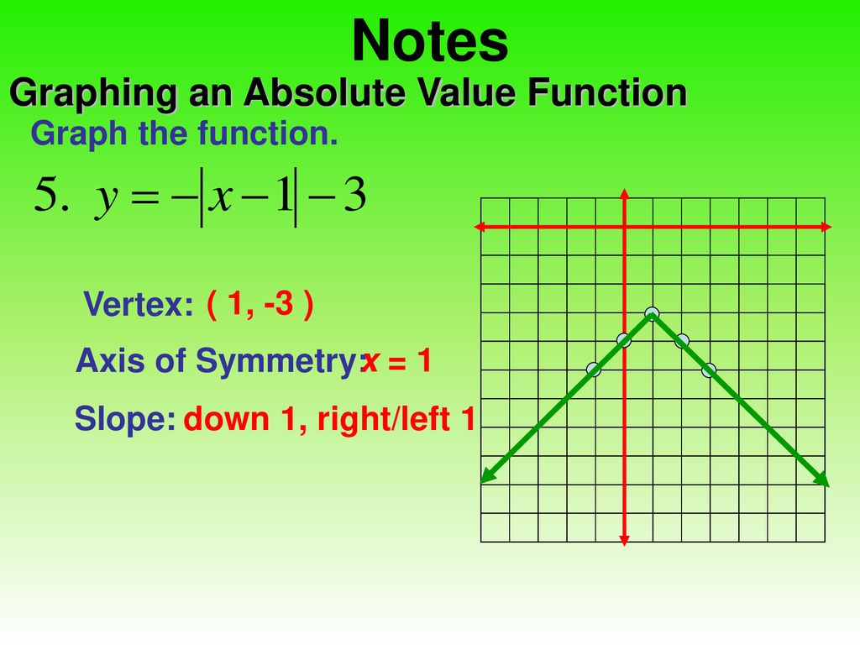

Slide 9
Vertical line Test for function
Not every curve you draw is the graph of a function. A function ƒ can have only one value ƒ(x) for each x in its domain, so no vertical line can intersect the graph of a function more than once.
Thus, a circle cannot be the graph of a function since some vertical lines intersect the circle twice. If a is in the domain of a function ƒ, then the vertical line will intersect the graph of ƒ in the single point (a, ƒ(a)).

Slide 10
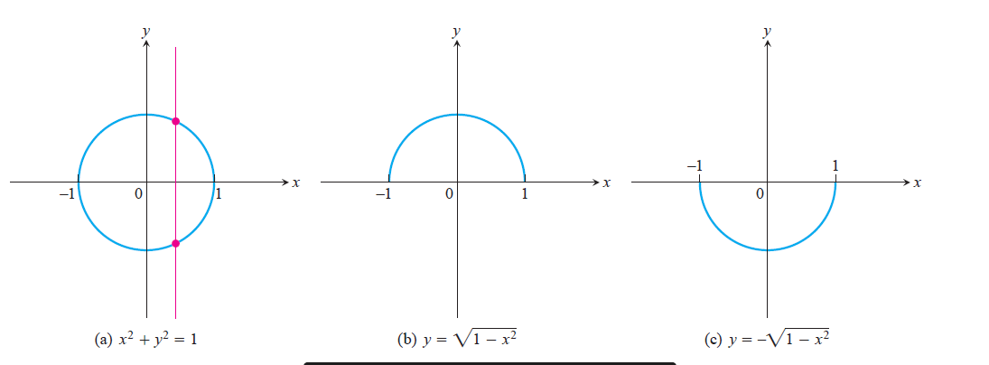

Slide 11
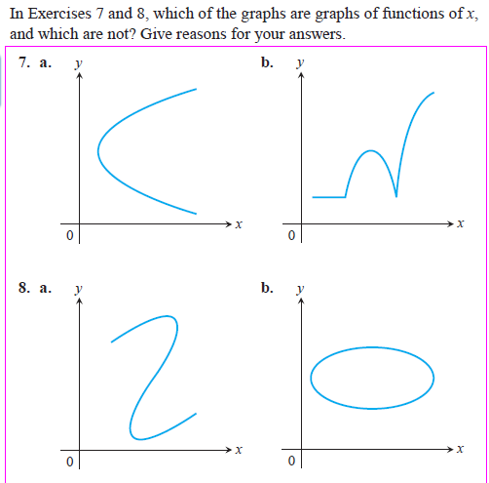
Solving Problems

